Slide 1
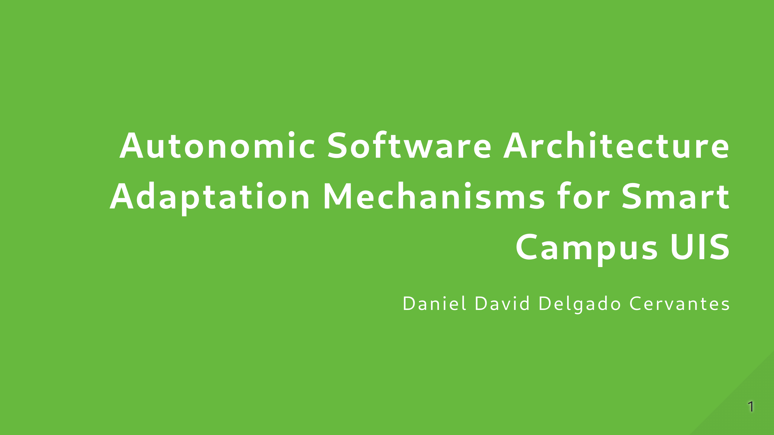

Slide 2


Slide 3
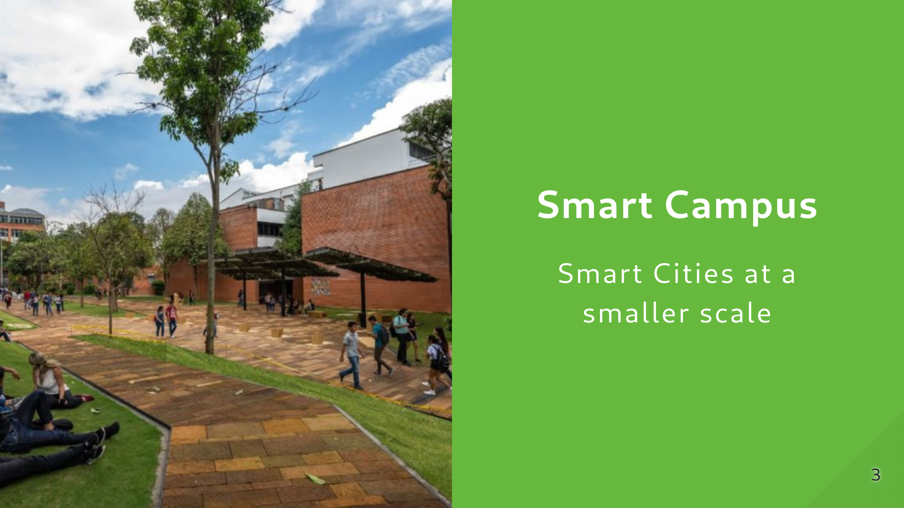
Notes:
If they know the context, might a as well skip this one Smart Campuses refer to the integration of IoT technologies in order to integrate the physical structure of Institutions, such as this one, in order to improve the overall experience of people in Campus. They have several applications that range from offering students services access to administrative services and information to the monitoring of areas for security or environmental purposes. This is mainly achieved with IoT applications that serve those needs. The more systems grow and expand, they're harder to manage as both the technical and human resources required to maintain them increases. This complexity can come from the amount of individual parts that compose the systems or the delicate balance of resources that they require to be operational. In the case of smart campuses, this can happen both due to the requirements that need to be met, the interactions with the physical world or the way things are distributed across the campus.

Slide 4
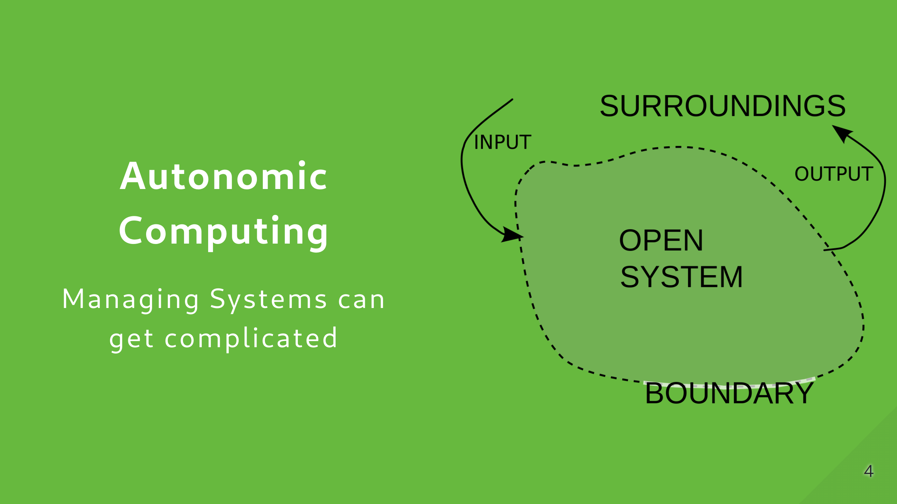
Notes:
This is where the concept of self-managed systems comes to play. The main idea, initially conceived by IBM, is to create systems with the capabilities and tools required to adapt their architecture and configurations in order to achieve some sort of high level goal set by the system administrators.

Slide 5
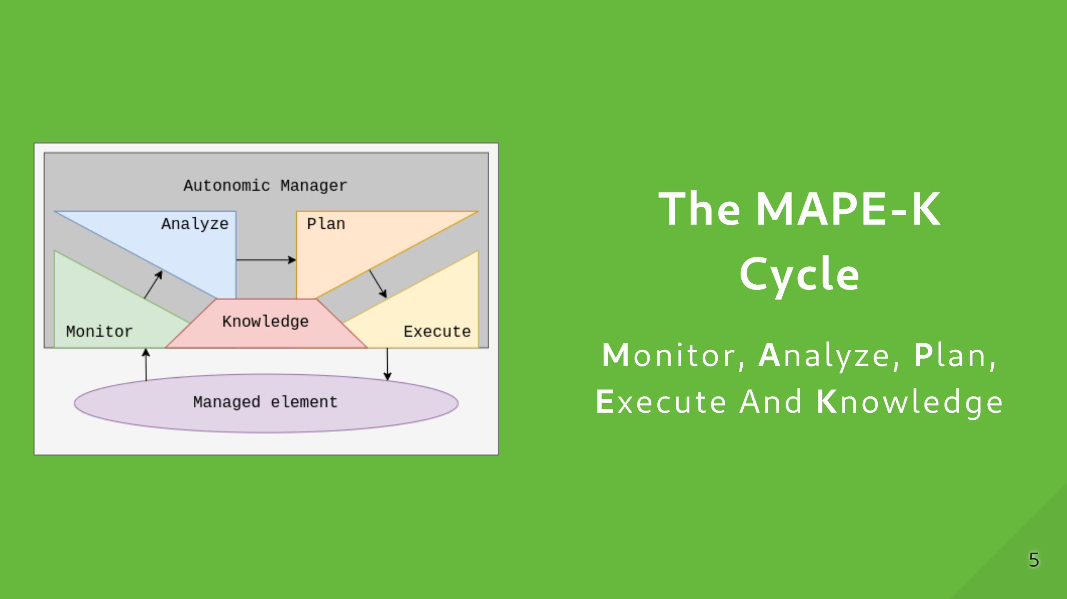
Notes:
There are several approaches to the implementation of Autonomic and self-managed systems. One of them is the MAPE-K Cycle. As described by IBM, it refers to each of the stages the systems should go through in order to adapt themselves to achieve a given goal. Monitor: Expand the knowledge base about the self and the surroundings Analyze: Evaluate the problems Plan: Generate a solution Execute: Apply what has been planned

Slide 6
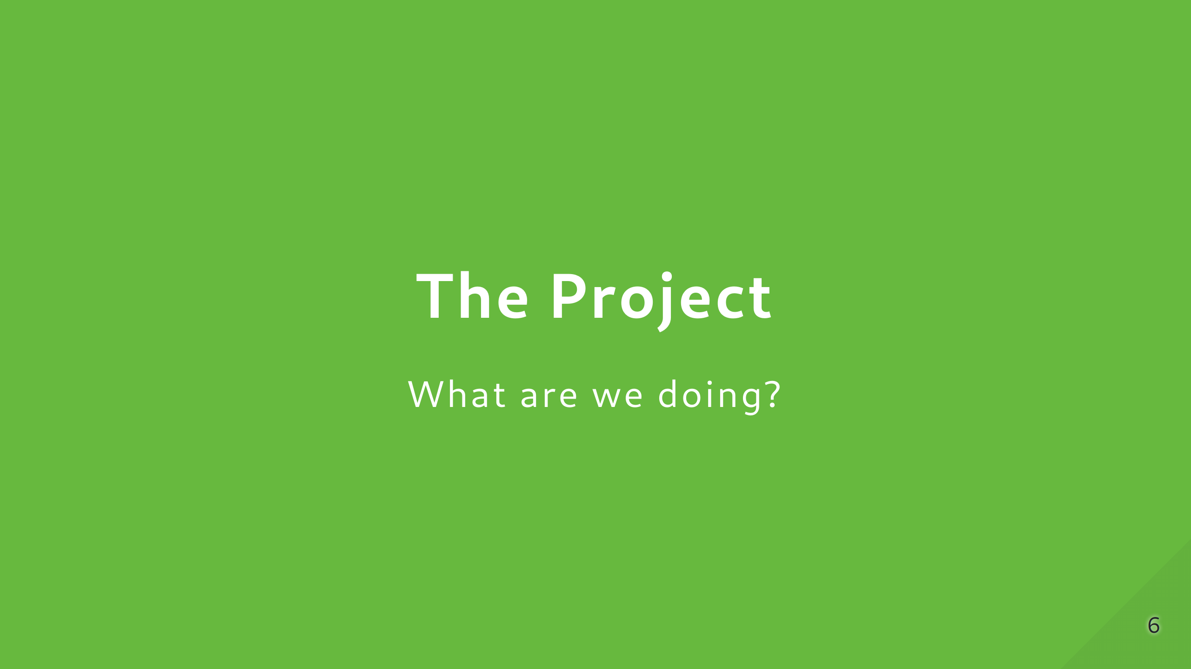

Slide 7
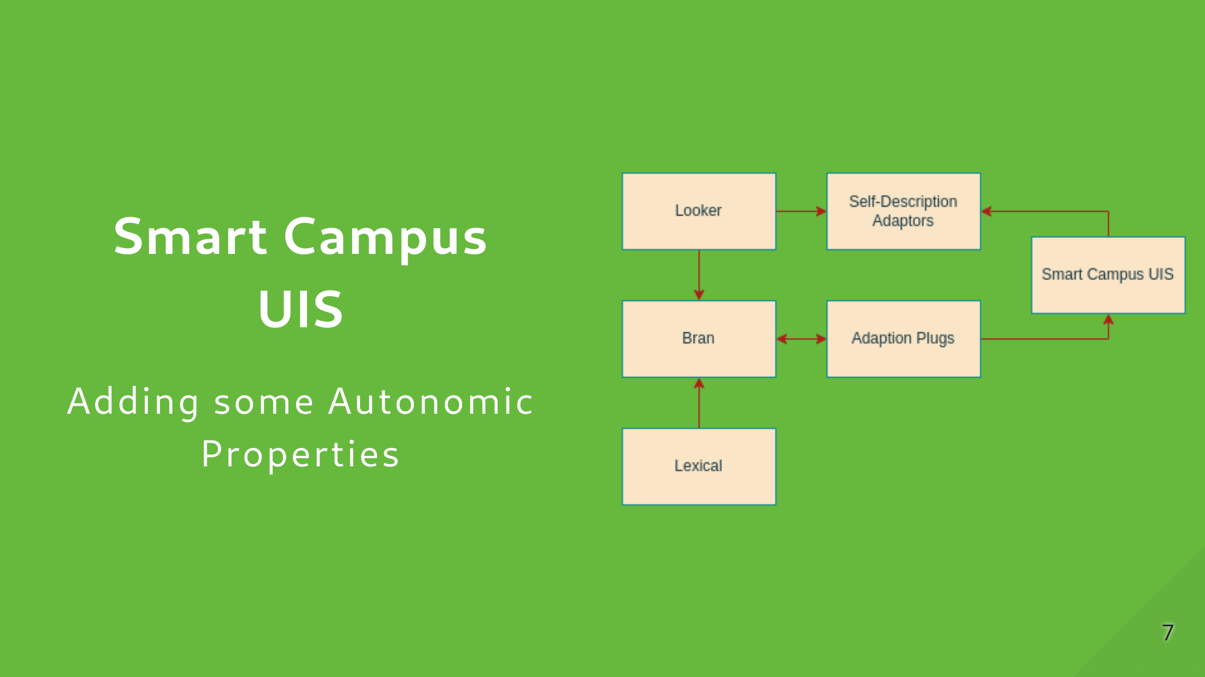
Notes:
As stated by the title, our main goal is the implementation of Autonomic Mechanisms that allow us to manipulate the architecture of Smart Campus UIS applications to comply with a given objetive by the system administrator

Slide 8
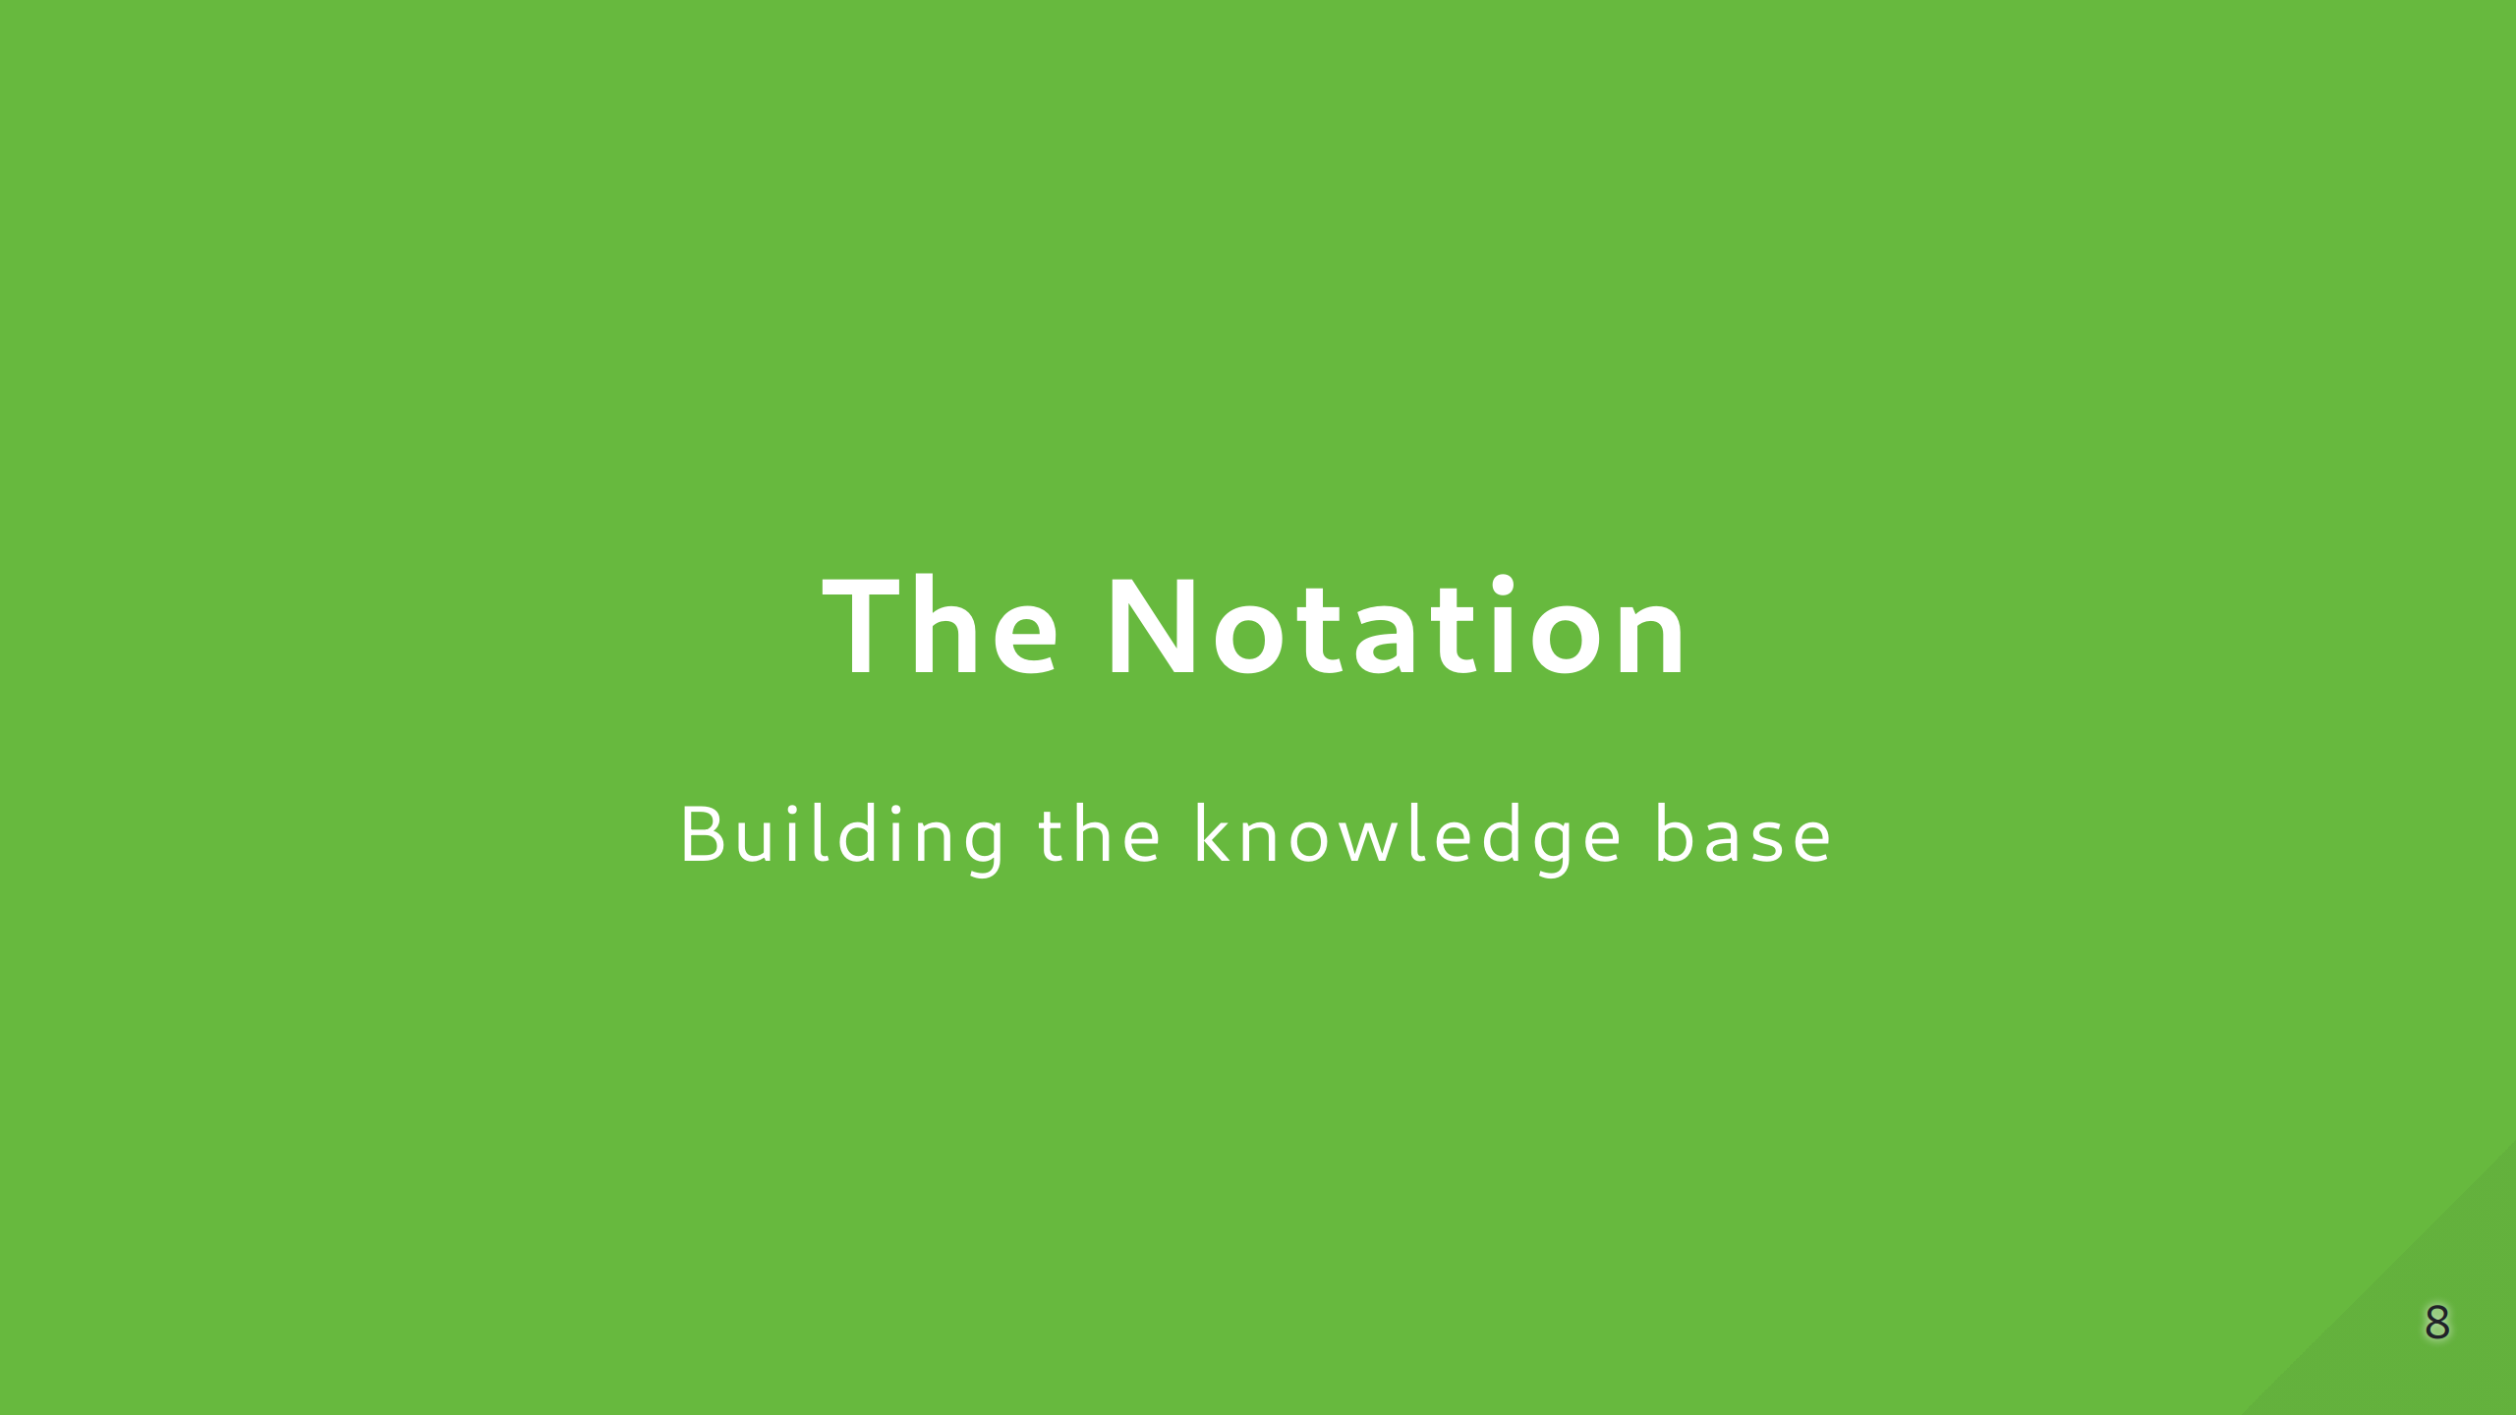

Slide 9
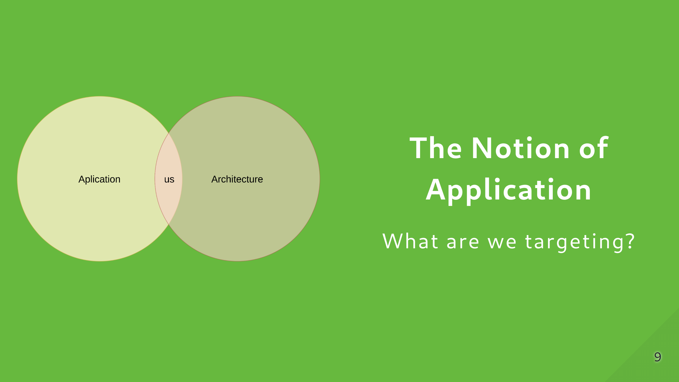

Slide 10
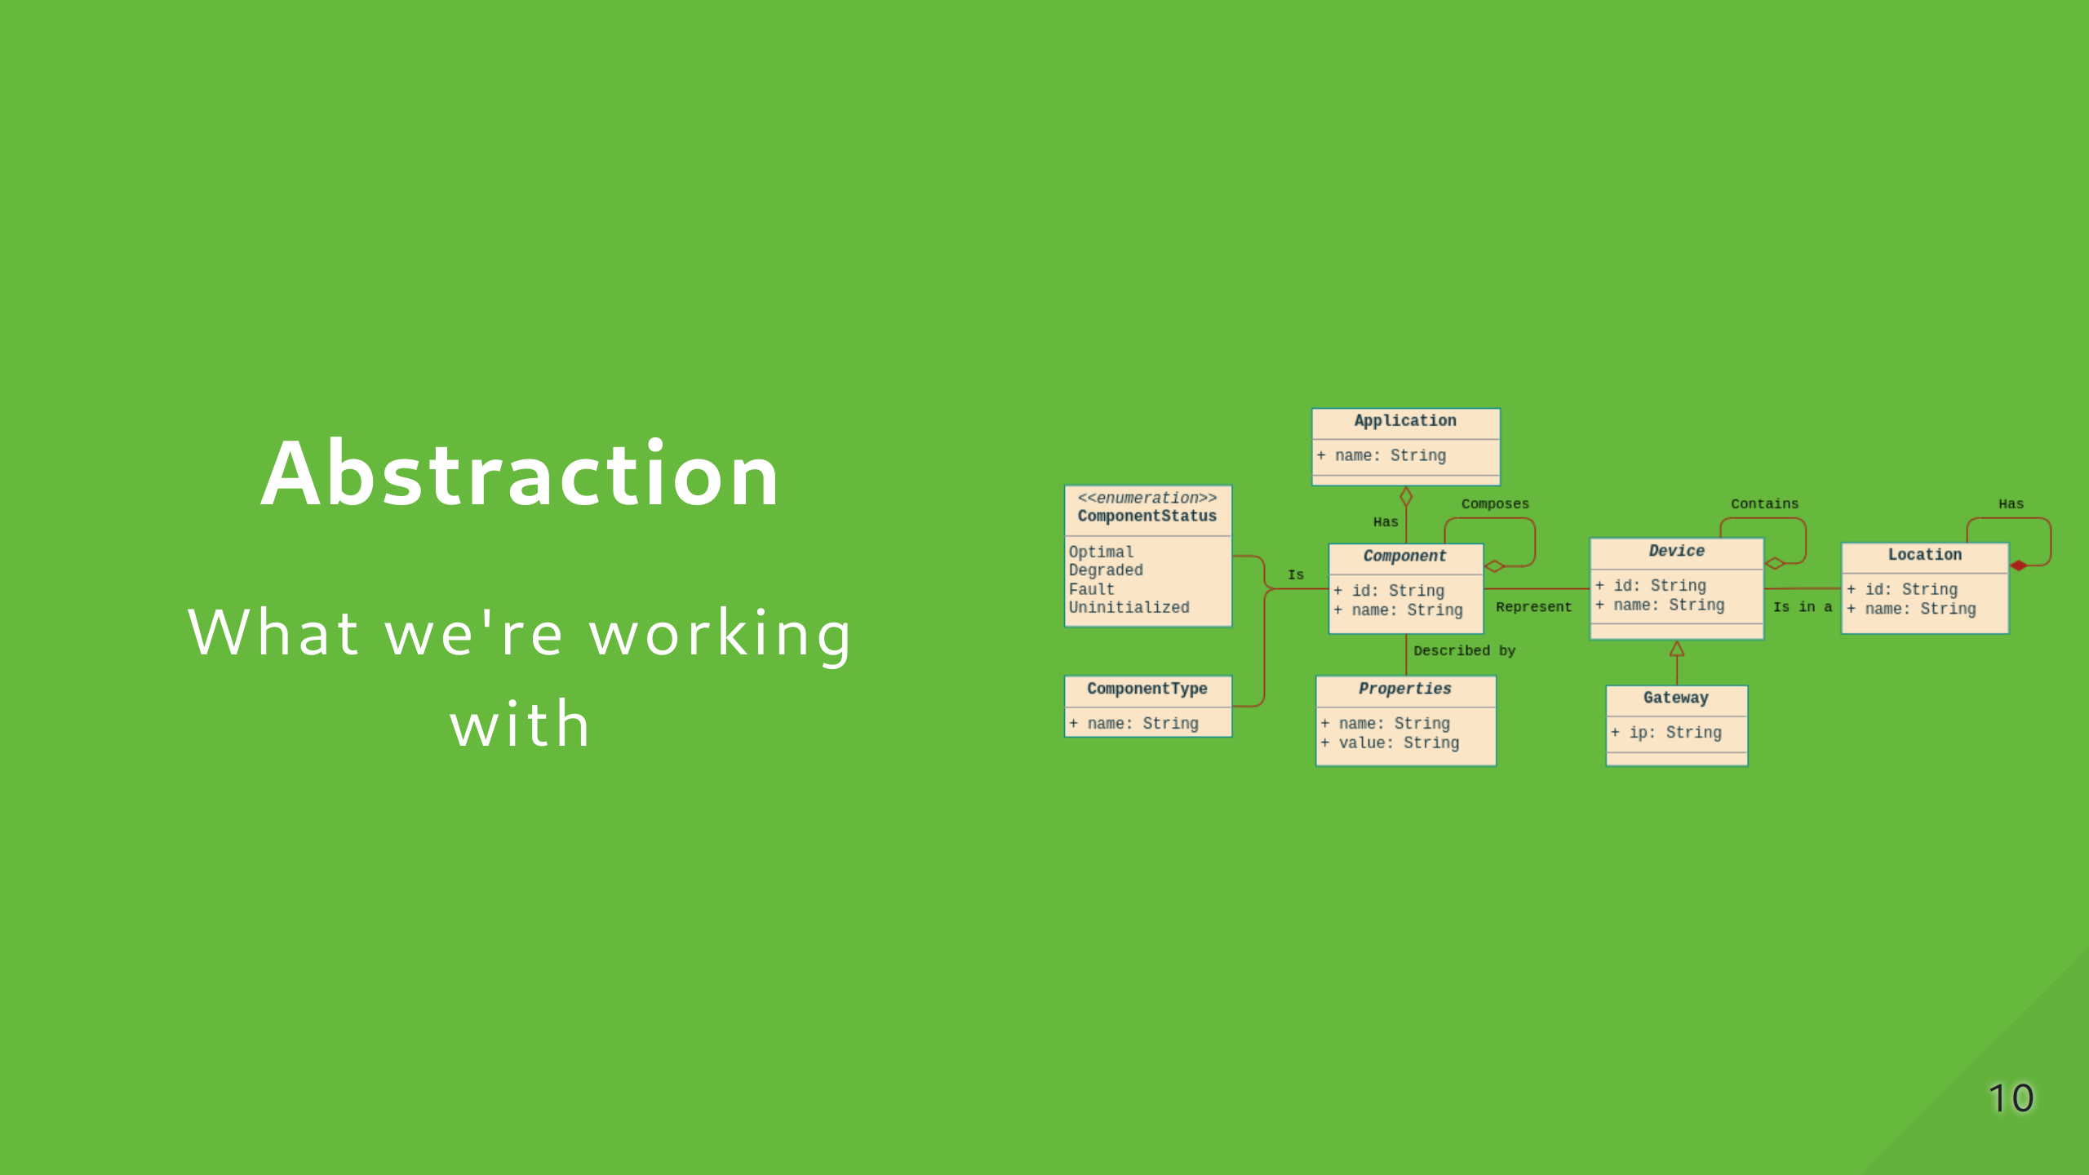

Slide 11
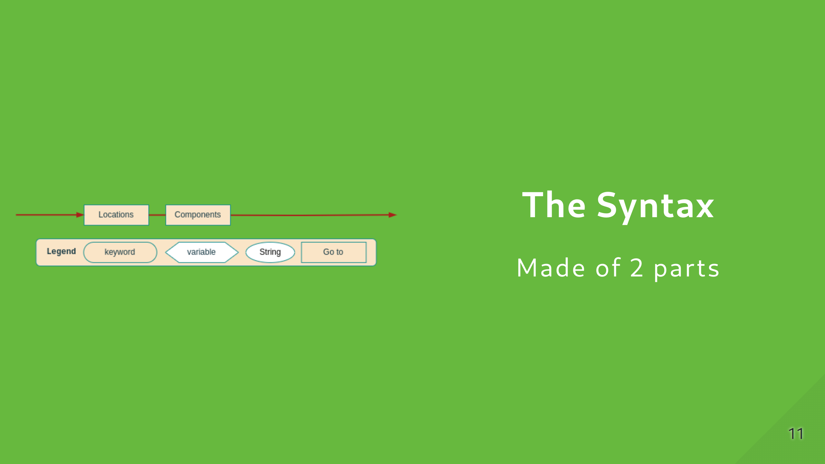

Slide 12
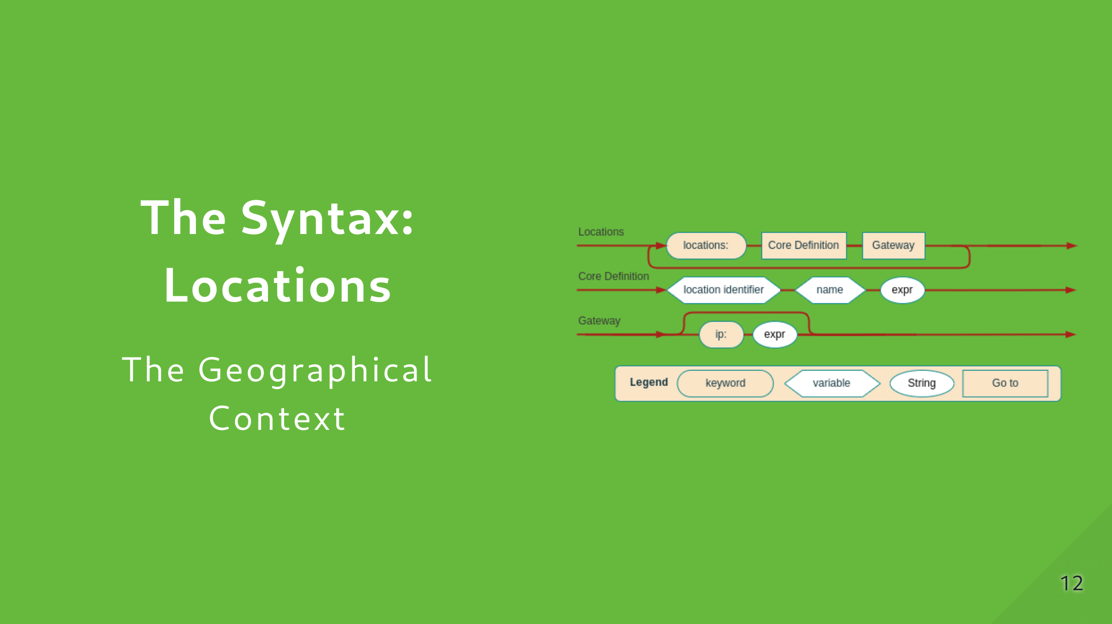

Slide 13
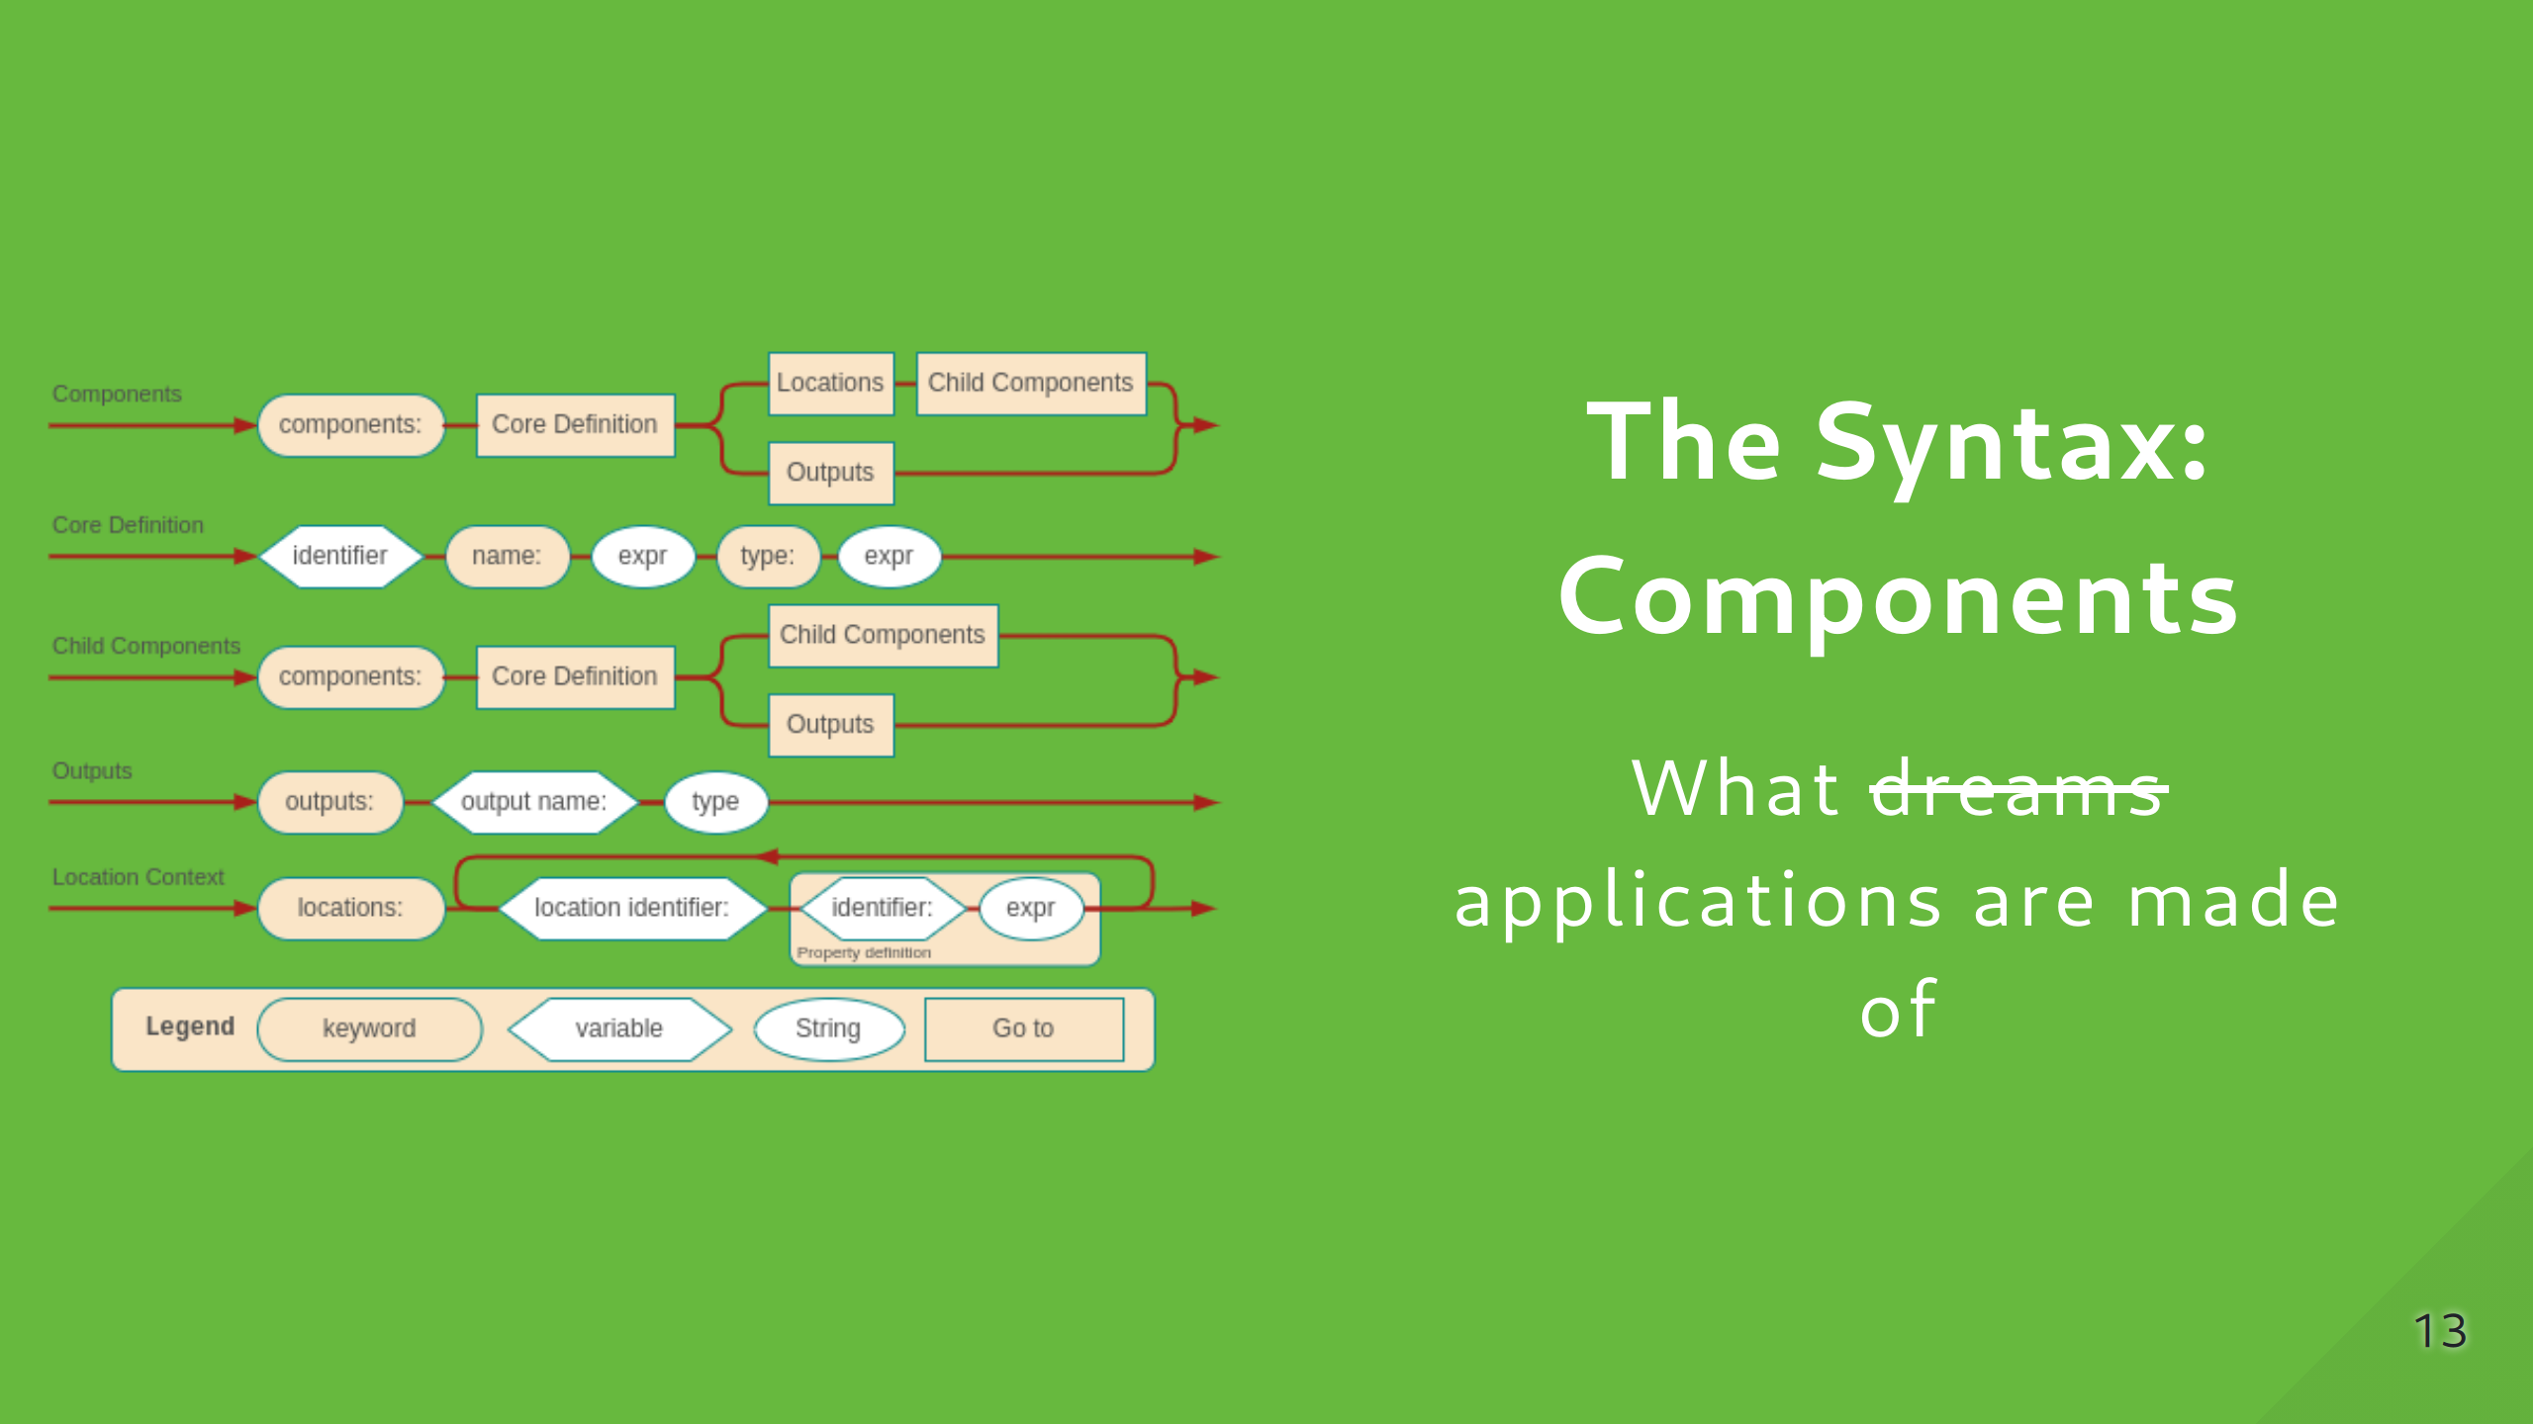

Slide 14
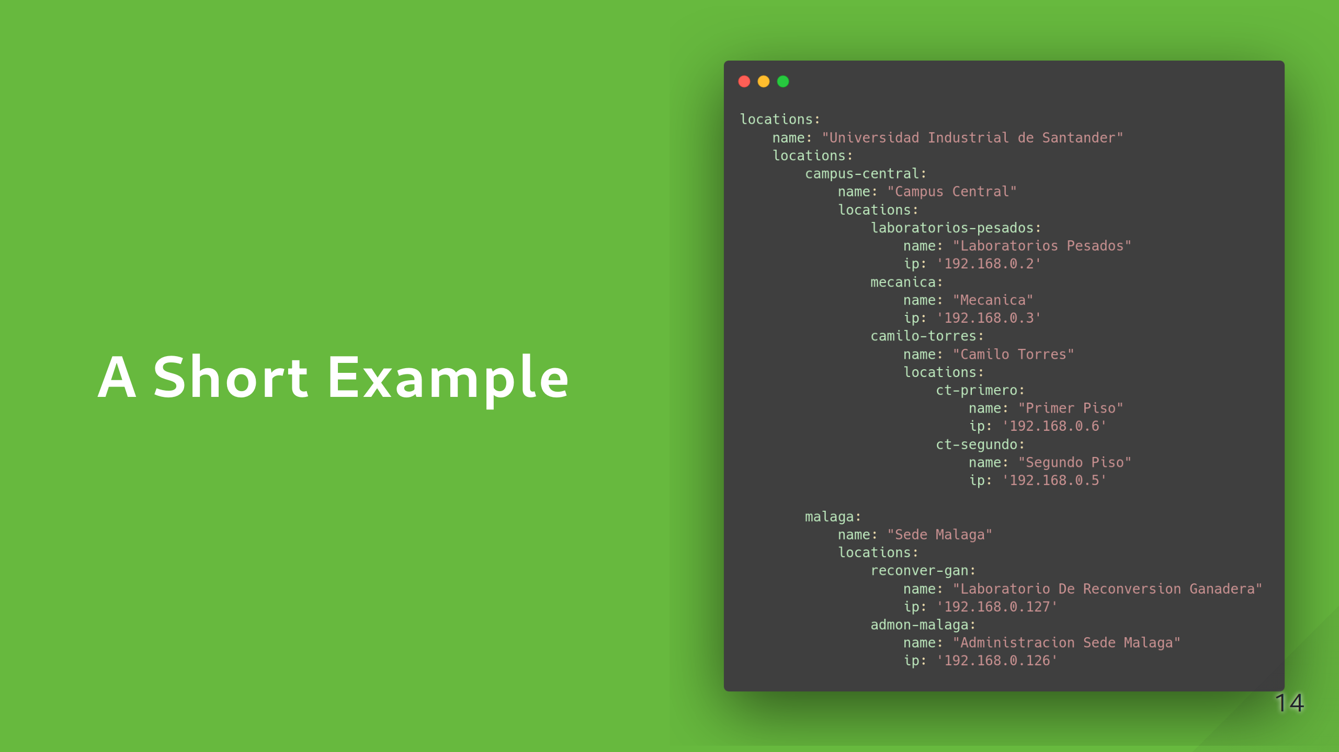

Slide 15
